Slide 1

Module 16 - Application Case Study – Electrostatic Potential Calculation
Lecture 16.1 - Electrostatic Potential Calculation - Part 1

Slide 2
Objective
To learn how to apply parallel programming techniques to an application
Thread coarsening for more work efficiency
Data structure padding for reduced divergence
Memory access locality and pre-computation techniques

Slide 3
VMD
Visual Molecular Dynamics
Visualizing, animating, and analyzing bio-molecular systems
More than 200,000 users worldwide
Batch (movie making) vs. interactive mode
Runs on laptops, desktops, clusters, supercomputers

Slide 4
Electrostatic Potential Map
Calculate initial electrostatic potential map around the simulated structure considering the contributions of all atoms
Most time consuming, focus of our example.
ri,j: distance from grid (lattice) point j to atom[i]
potential[j]: potential at grid (lattice) point being evaluated
atom[i]

Slide 5
Electrostatic Potential Calculation
The contribution of atom[i] to the electrostatic potential at lattice[j] is potential[j] = atom[i].charge / rij.
In the Direct Coulomb Summation method, the total potential at lattice point j is the sum of contributions from all atoms in the system.

Slide 6
Overview of Direct Coulomb Summation (DCS) Algorithm
One way to compute the electrostatic potentials on a grid, ideally suited for the GPU
All atoms affect all map lattice points, most accurate
For each lattice point, sum potential contributions for all atoms in the simulated structure:
potential += charge[i] / (distance to atom[i])
Approximation-based methods such as cut-off summation can achieve much higher performance at the cost of some numerical accuracy and flexibility

Slide 7
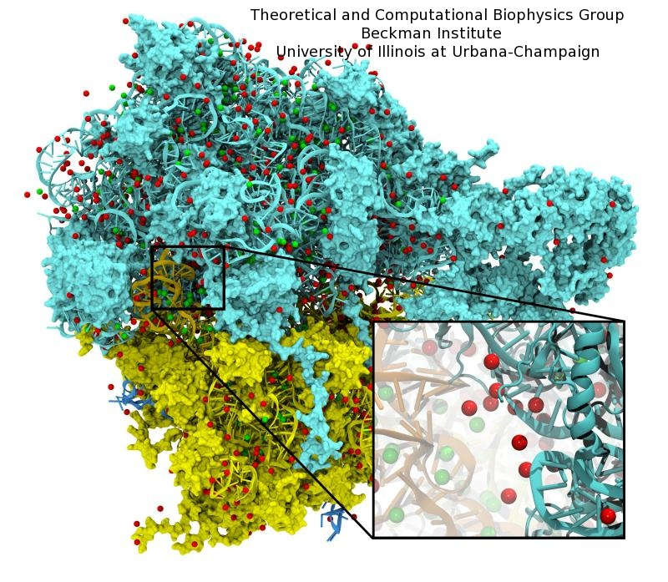
Irregular Input vs. Regular Output
Atoms come from modeled molecular structures, solvent (water) and ions
Irregular by necessity
Energy grid models the electrostatic potential value at regularly spaced points
Regular by design

Slide 8
Summary of Sequential C Version
Algorithm is input oriented
For each input atom, calculate its contribution to all grid points in an x-y slice
Output (energy grid) is regular
Simple linear mapping between grid point indices and modeled physical coordinates
Input (atom) is irregular
Modeled x,y,z coordinate of each atom needs to be stored in the atom array
The algorithm is efficient in performing minimal number of calculations on distances, coordinates, etc.

Slide 9
A Sequential C Version
void cenergy(float *energygrid, dim3 grid, float gridspacing, float z, const float *atoms, int numatoms) {
int atomarrdim = numatoms * 4; //x,y,z, and charge info for each atom
int grid_slice_offset = (grid.x*grid.y*z) / gridspacing;
for (int n=0; n<atomarrdim; n+=4) { // calculate potential contribution of each atom
float dz = z - atoms[n+2]; // all grid points in a slice have the same z value
float dz2 = dz*dz;
float charge = atoms[n+3];
for (int j=0; j<grid.y; j++) {
float y = gridspacing * (float) j;
float dy = y - atoms[n+1]; // all grid points in a row have the same y value
float dy2 = dy*dy;
int grid_row_offset = grid_slice_offset+ grid.x*j;
for (int i=0; i<grid.x; i++) {
float x = gridspacing * (float) i;
float dx = x - atoms[n ];
energygrid[grid_row_offset + i] += charge / sqrtf(dx*dx + dy2+ dz2);
}
}
}
}
The grid parameter gives the number of grid points in each dimension of the lattice.

Slide 10
A Sequential C Version
void cenergy(float *energygrid, dim3 grid, float gridspacing, float z, const float *atoms, int numatoms) {
int atomarrdim = numatoms * 4; //x,y,z, and charge info for each atom
int grid_slice_offset = (grid.x*grid.y*z) / gridspacing;
for (int n=0; n<atomarrdim; n+=4) { // calculate potential contribution of each atom
float dz = z - atoms[n+2]; // all grid points in a slice have the same z value
float dz2 = dz*dz;
float charge = atoms[n+3];
for (int j=0; j<grid.y; j++) {
float y = gridspacing * (float) j;
float dy = y - atoms[n+1]; // all grid points in a row have the same y value
float dy2 = dy*dy;
int grid_row_offset = grid_slice_offset+ grid.x*j;
for (int i=0; i<grid.x; i++) {
float x = gridspacing * (float) i;
float dx = x - atoms[n ];
energygrid[grid_row_offset + i] += charge / sqrtf(dx*dx + dy2+ dz2);
}
}
}
}
The grid parameter gives the number of grid points in each dimension of the lattice.

Slide 11
A Sequential C Version
void cenergy(float *energygrid, dim3 grid, float gridspacing, float z, const float *atoms, int numatoms) {
int atomarrdim = numatoms * 4; //x,y,z, and charge info for each atom
int grid_slice_offset = (grid.x*grid.y*z) / gridspacing;
for (int n=0; n<atomarrdim; n+=4) { // calculate potential contribution of each atom
float dz = z - atoms[n+2]; // all grid points in a slice have the same z value
float dz2 = dz*dz;
float charge = atoms[n+3];
for (int j=0; j<grid.y; j++) {
float y = gridspacing * (float) j;
float dy = y - atoms[n+1]; // all grid points in a row have the same y value
float dy2 = dy*dy;
int grid_row_offset = grid_slice_offset+ grid.x*j;
for (int i=0; i<grid.x; i++) {
float x = gridspacing * (float) i;
float dx = x - atoms[n ];
energygrid[grid_row_offset + i] += charge / sqrtf(dx*dx + dy2+ dz2);
}
}
}
}
Input oriented
The grid parameter gives the number of grid points in each dimension of the lattice.

Slide 12
An Sequential C Version
void cenergy(float *energygrid, dim3 grid, float gridspacing, float z, const float *atoms, int numatoms) {
int grid_slice_offset = (grid.x*grid.y*z) / gridspacing;
int atomarrdim = numatoms * 4; //x,y,z, and charge info for each atom
for (int n=0; n<atomarrdim; n+=4) { // calculate potential contribution of each atom
float dz = z - atoms[n+2]; // all grid points in a slice have the same z value
float dz2 = dz*dz;
float charge = atoms[n+3];
for (int j=0; j<grid.y; j++) {
float y = gridspacing * (float) j;
float dy = y - atoms[n+1]; // all grid points in a row have the same y value
float dy2 = dy*dy;
int grid_row_offset = grid_slice_offset+ grid.x*j;
for (int i=0; i<grid.x; i++) {
float x = gridspacing * (float) i;
float dx = x - atoms[n ];
energygrid[grid_row_offset + i] += charge / sqrtf(dx*dx + dy2+ dz2);
}
}
}
}

Slide 13
A More Optimized Sequential C Version
void cenergy(float *energygrid, dim3 grid, float gridspacing, float z, const float *atoms, int numatoms) {
int grid_slice_offset = (grid.x*grid.y*z) / gridspacing;
int atomarrdim = numatoms * 4; //x,y,z, and charge info for each atom
for (int n=0; n<atomarrdim; n+=4) { // calculate potential contribution of each atom
float dz = z - atoms[n+2]; // all grid points in a slice have the same z value
float dz2 = dz*dz;
float charge = atoms[n+3];
for (int j=0; j<grid.y; j++) {
float y = gridspacing * (float) j;
float dy = y - atoms[n+1]; // all grid points in a row have the same y value
float dy2 = dy*dy;
int grid_row_offset = grid_slice_offset+ grid.x*j;
for (int i=0; i<grid.x; i++) {
float x = gridspacing * (float) i;
float dx = x - atoms[n ];
energygrid[grid_row_offset + i] += charge / sqrtf(dx*dx + dy2+ dz2);
}
}
}
}

Slide 14
An Intuitive Sequential C Version
void cenergy(float *energygrid, dim3 grid, float gridspacing, float z, const float *atoms, int numatoms) {
int grid_slice_offset = (grid.x*grid.y*z) / gridspacing;
int atomarrdim = numatoms * 4; //x,y,z, and charge info for each atom
for (int n=0; n<atomarrdim; n+=4) { // calculate potential contribution of each atom
float dz = z - atoms[n+2]; // all grid points in a slice have the same z value
float dz2 = dz*dz;
float charge = atoms[n+3];
for (int j=0; j<grid.y; j++) {
float y = gridspacing * (float) j;
float dy = y - atoms[n+1]; // all grid points in a row have the same y value
float dy2 = dy*dy;
int grid_row_offset = grid_slice_offset+ grid.x*j;
for (int i=0; i<grid.x; i++) {
float x = gridspacing * (float) i;
float dx = x - atoms[n ];
energygrid[grid_row_offset + i] += charge / sqrtf(dx*dx + dy2+ dz2);
}
}
}
}

Slide 15
CUDA DCS Implementation Overview
Allocate and initialize potential map memory on host CPU
Allocate potential map slice buffer on GPU
Preprocess atom coordinates and charges
Loop over potential map slices:
Copy potential map slice from host to GPU
Loop over groups of atoms:
Copy atom data to GPU
Run CUDA Kernel on atoms and potential map slice on GPU
Copy potential map slice from GPU to host
Free resources

Slide 16
Straightforward CUDA Parallelization
Use each thread to compute the contribution of an atom to all grid points in the current slice
Scatter parallelization
Kernel code largely correspond to intuitive CPU version with outer loop stripped
Each thread corresponds to an outer loop iteration of CPU version
numatoms used in kernel launch configuration of the host code

Slide 17
A Very Slow DCS Scatter Kernel!
void __global__ cenergy(float *energygrid, float *atoms, dim3 grid, float gridspacing, float z) {
int n = (blockIdx.x * blockDim .x + threadIdx.x) * 4;
float dz = z - atoms[n+2]; // all grid points in a slice have the same z value
float dz2 = dz*dz;
int grid_slice_offset = (grid.x*grid.y*z) / gridspacing;
float charge = atoms[n+3];
for (int j=0; j<grid.y; j++) {
float y = gridspacing * (float) j;
float dy = y - atoms[n+1]; // all grid points in a row have the same y value
float dy2 = dy*dy;
int grid_row_offset = grid_slice_offset+ grid.x*j;
for (int i=0; i<grid.x; i++) {
float x = gridspacing * (float) i;
float dx = x - atoms[n ];
energygrid[grid_row_offset + i] += charge / sqrtf(dx*dx + dy2+ dz2));
}
}
}
}
Needs to be calculated redundantly by every thread

Slide 18
A Very Slow DCS Scatter Kernel!
void __global__ cenergy(float *energygrid, float *atoms, dim3 grid, float gridspacing, float z) {
int n = (blockIdx.x * blockDim .x + threadIdx.x) *4;
float dz = z - atoms[n+2]; // all grid points in a slice have the same z value
float dz2 = dz*dz;
int grid_slice_offset = (grid.x*grid.y*z) / gridspacing;
float charge = atoms[n+3];
for (int j=0; j<grid.y; j++) {
float y = gridspacing * (float) j;
float dy = y - atoms[n+1]; // all grid points in a row have the same y value
float dy2 = dy*dy;
int grid_row_offset = grid_slice_offset+ grid.x*j;
for (int i=0; i<grid.x; i++) {
float x = gridspacing * (float) i;
float dx = x - atoms[n ];
energygrid[grid_row_offset + i] += charge / sqrtf(dx*dx + dy2+ dz2));
}
}
}
}
Needs to be done as an atomic operation

Slide 19
Scatter Parallelization
in
Thread 0
Thread 1
…
iterate over output
out

Slide 20
Why is input oriented algorithm often used?
In practice, each in element does not have significant effect on all out elements
Output tends to be much more regular than input
Input usually comes as sparse data structure, where coordinates are part of the data
One needs to look at the input data to see if an input is relevant to an output value
Output is usually a regular, grid
Given an input value, one can easily find output via index calculation

Slide 21
Pros and Cons of the Scatter Kernel
Pros
Follows closely the simple CPU version
Good for software engineering and code maintenance
Preserves computation efficiency (coordinates, distances, offsets) of sequential code
Cons
The atomic add serializes the execution, very slow!
Not even worth trying this.

Slide 22
The GPU Teaching Kit is licensed by NVIDIA and the University of Illinois under the Creative Commons Attribution-NonCommercial 4.0 International License.

